Slide 1
Wi-Fi - IEEE Standards and the future of Wi-Fi
Mingnan Yuan
Department of Electrical and Computer Engineering
Auburn University
March 9, 2016

Slide 2
Outline
History of IEEE 802.11 WLAN
Very high throughput signal field
Multiple-input and multiple-output
BEAMFORMING
Future Techniques

Slide 3
History of IEEE 802.11 WLAN
802.11 defined only the data rate of 1 or 2 Mb/s operated at 2.4 GHz band using.
IEEE expanded on the original 802.11 standard in July 1999, creating the 802.11b specification. 802.11b supports bandwidth up to 11 Mbps. 802.11b uses the same unregulated radio signaling frequency (2.4 GHz) as the original 802.11 standard.
802.11g attempts to combine the best of both 802.11a and 802.11b. 802.11g supports bandwidth up to 54 Mbps, and it uses the 2.4 GHz frequency for greater range.
Industry standards groups ratified 802.11n in 2009 with specifications providing for up to 300 Mbps of network bandwidth.
802.11ac bandwidth rated up to 1300 Mbps on the 5 GHz band.

Slide 4
History of IEEE 802.11 WLAN
802.11ac chooses a mixed-mode format with new portion. This amendments enable an efficient preamble design for MIMO operation. After 20 m sec long legacy portion of the preamble, more control signals are defined in very high throughput signal field (VHT-SIG) for 11ac.

Slide 5
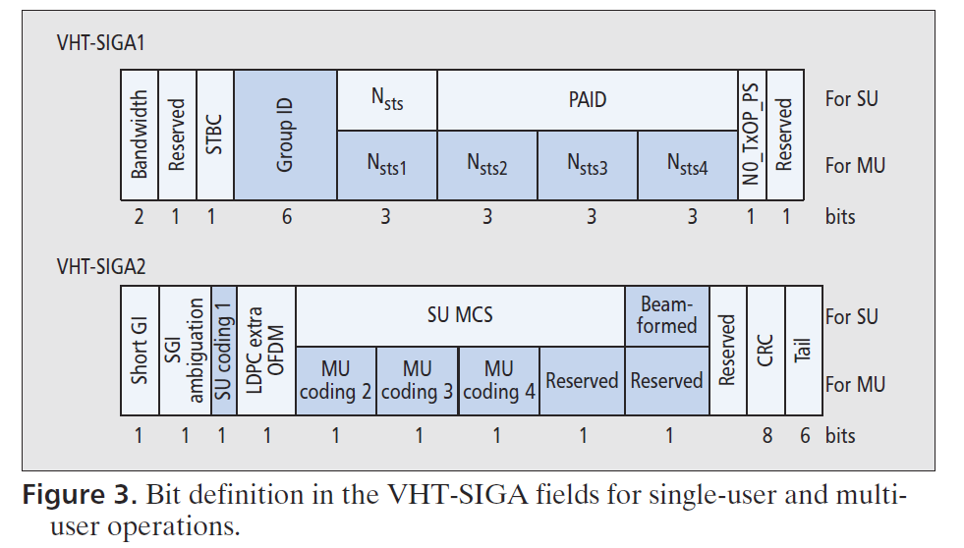
Very high throughput signal field

Slide 6
Multiple-input and multiple-output
MIMO is a method for multiplying the capacity of a radio link using multiple transmit and receive antennas to exploit multipath propagation. MIMO has become an essential element of wireless communication standards.
With a new MU-MIMO feature introduced in 802.11ac, the VHT-SIG should indicate necessary information for recipients to process MUMIMO packets.

Slide 7
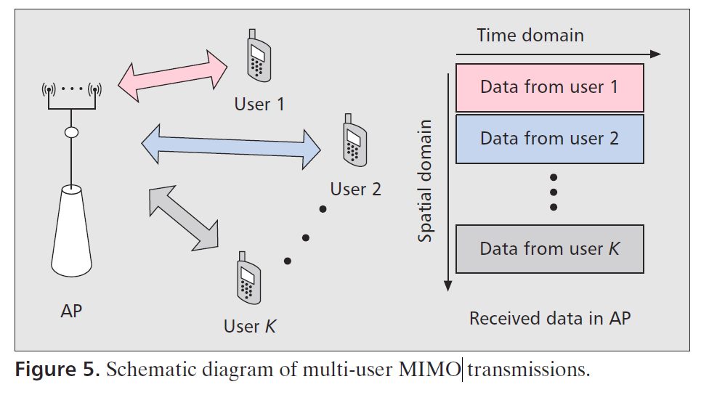
Multi-user MIMO transmissions

Slide 8
BEAMFORMING
Beam-forming is one of advanced MIMO techniques to enhance the throughput significantly. Antenna coordination for directional beams is enabled with an aid of channel state information (CSI) feedback, and thus it is essential to efficiently deliver such information from a beam-formee to a beam-former.

Slide 9
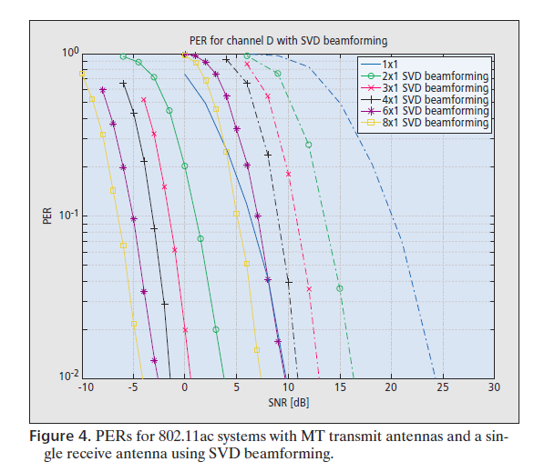
PERFORMANCE OF BEAMFORMING

Slide 10
Future Techniques
Sub-band orthogonal multiplexing division multiple access (OFDMA)
UPLINK MU-MIMO
Full duplex transmission

Slide 11
References
[1] B.L, 2006, Achieving optimal performance in IEEE 802.11 wireless LANs with the combination of link adaptation and adaptive backoff
[2] Xu Bao, 2014, Protocol Design and Capacity Analysis in Hybrid Network of Visible Light Communication and OFDMA Systems
[3] Joonsuk Kim, 2015, 802.11 WLAN: History and New Enabling MIMO Techniques for Next Generation Standards
[4] Moussa Ayyash, 2016, Coexistence of WiFi and LiFi towards 5G: Concepts, Opportunities, and Challenges
[5] Nam Nguyen, 2015, A Novel WLAN Roaming Decision and Selection Scheme for Mobile Data Offloading
[6] Sharad S Wagha, 2015, Performance Evaluation of IEEE 802.15.4 Protocol Under Coexistence of Wi-Fi 802.11b

